Slide 1
Outpost Map Proposal
By Lauren Pearce

Slide 2
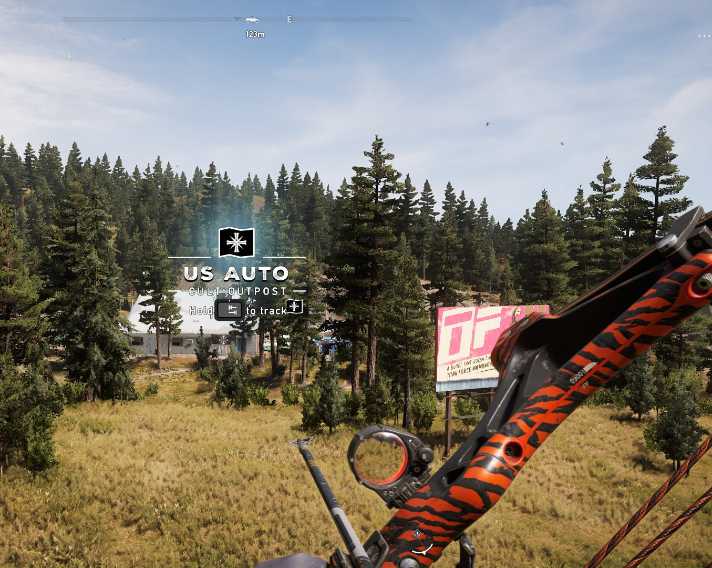
What is Far Cry 5?
Far Cry 5 is an open-world FPS
What is an outpost?
An outpost is an area which is an area controlled by enemies which to complete requires all enemies to be killed.

Slide 3
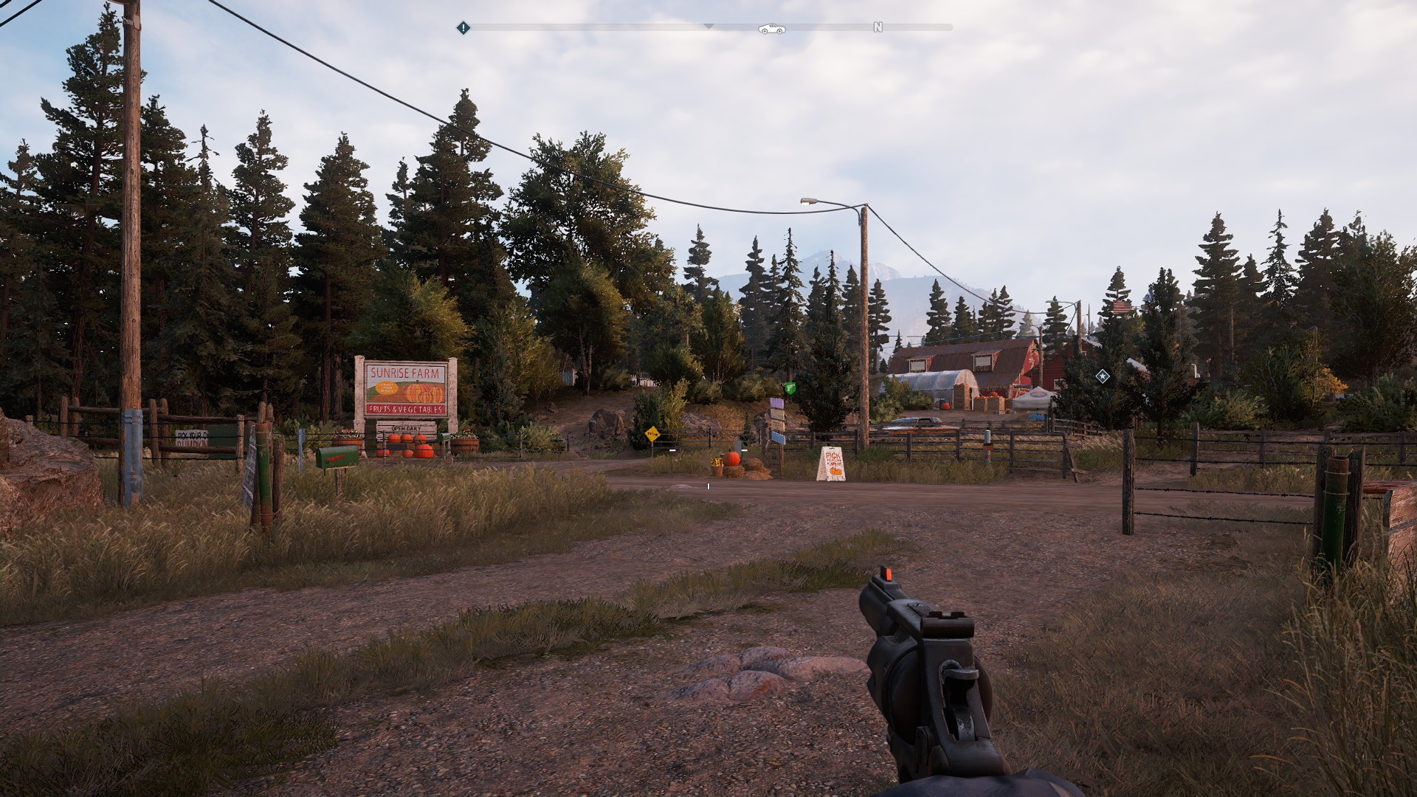
Outpost Features
Outposts are environments that were once commercial or residential, which have been adapted into enemy settlements.
They usually consist of/have:
A distinct architectural core, where its pre-cult identity can still be discerned (i.e. a farm, a hotel), to continue the narrative of a sudden cult takeover.
A vantage point on the outskirts to scout the area and zip-wire in
Multiple entrances, the front often encouraging open combat, whilst side entrances encourage stealth, through tall grass, or makeshift cover
An alarm that enemies can use to call reinforcements
A sniper/enemy with high ground advantage
Smaller interconnecting indoor areas
Multiple ways to access high grounds, from grappling to jumping on crates
Access to a road nearby

Slide 4
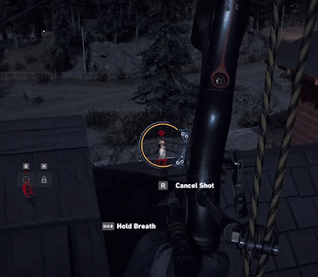
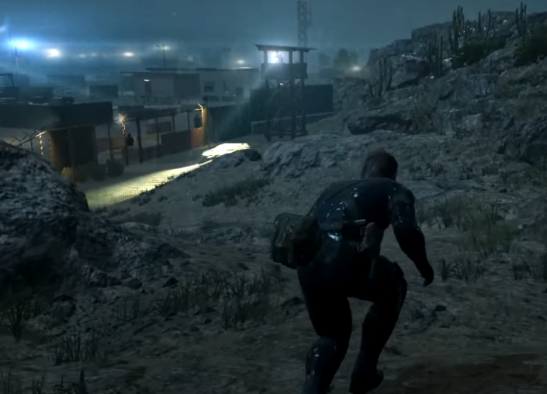
Design Motivations
Has a less obvious dominant strategy and veers away from sniper perch paradises, for example Seed Ranch (FC5) suffers from this
Stealth transitional areas in the mission “The Confession” for pacing diversity
Deus Ex Mankind Divided’s interior design that allows for stealth or aggressive approaches
Metal Gear Ground Zeroes terrain (that offers alternate routes) and cover placement

Slide 5
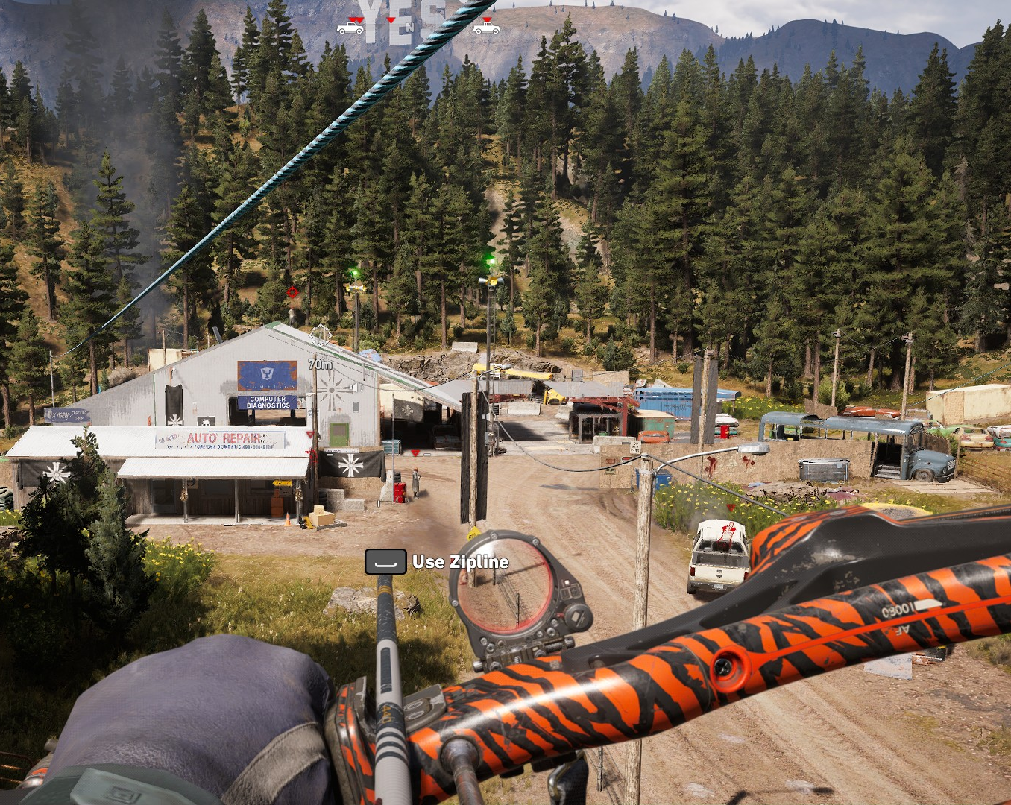
What makes a good outpost?
Makes the following three gameplay styles feel viable:
Sneaking (taking enemies down from behind)
Sniping
Aggressive (mid to close range fast combat)
In addition:
Is aesthetically believable and feels tied to the overarching narrative of Far Cry 5 (cult takeover)
Is consistent with affordability (i.e. ladders/ledges that can be climbed)
Balances sightlines for fairness, for example placing cover near ladders and side entrances
Forces the player to keep moving, so they cannot complete the outpost in one spot
Has a variety of entrances

Slide 6
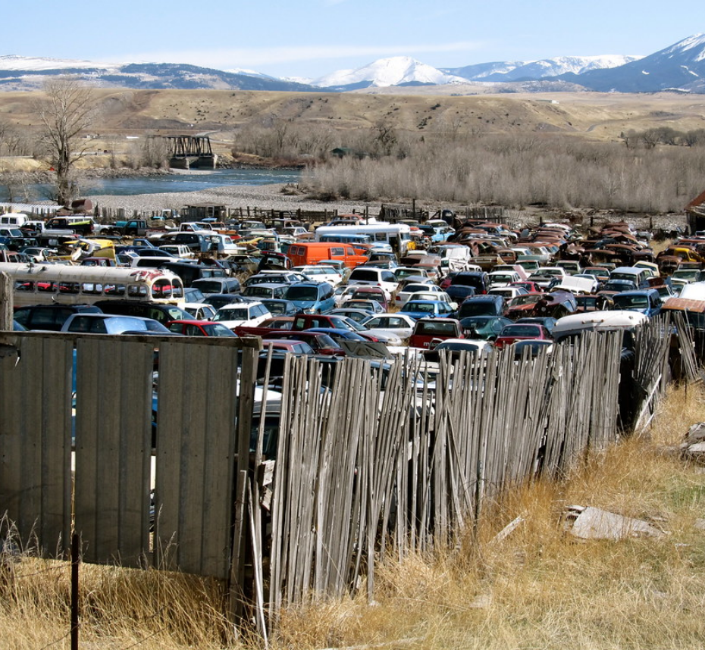
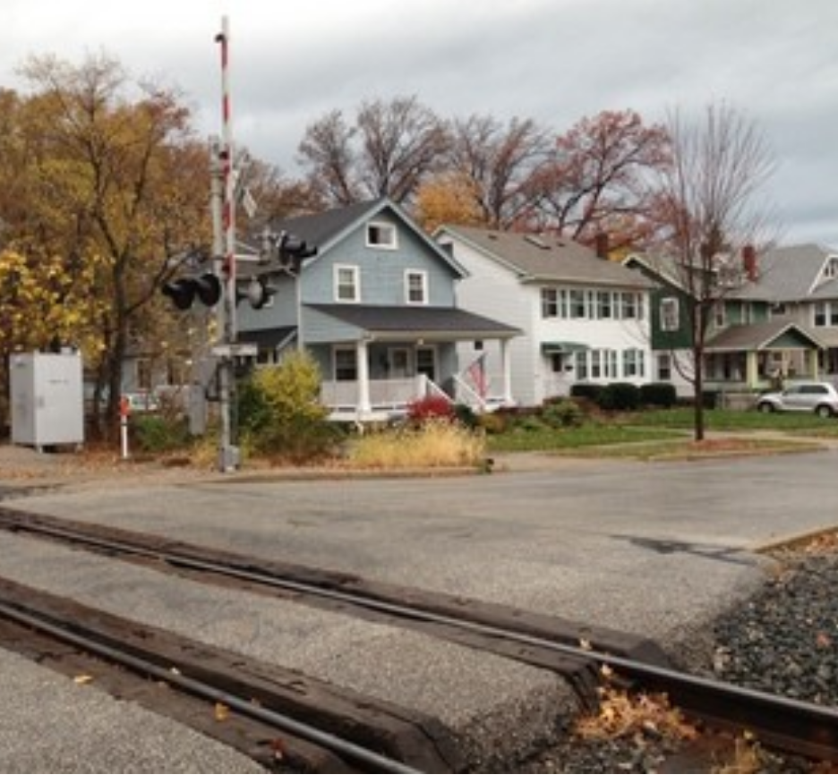
What is my level?
An outpost set in a metal scrap yard that sprawls onto a nearby residential area
A mission/story like structure created with distinct small sections each with their own pacing/difficulty
Environmental story telling detailing the fates of the residents
Roughly 6-10mins but significantly shorter if replayed

Slide 7
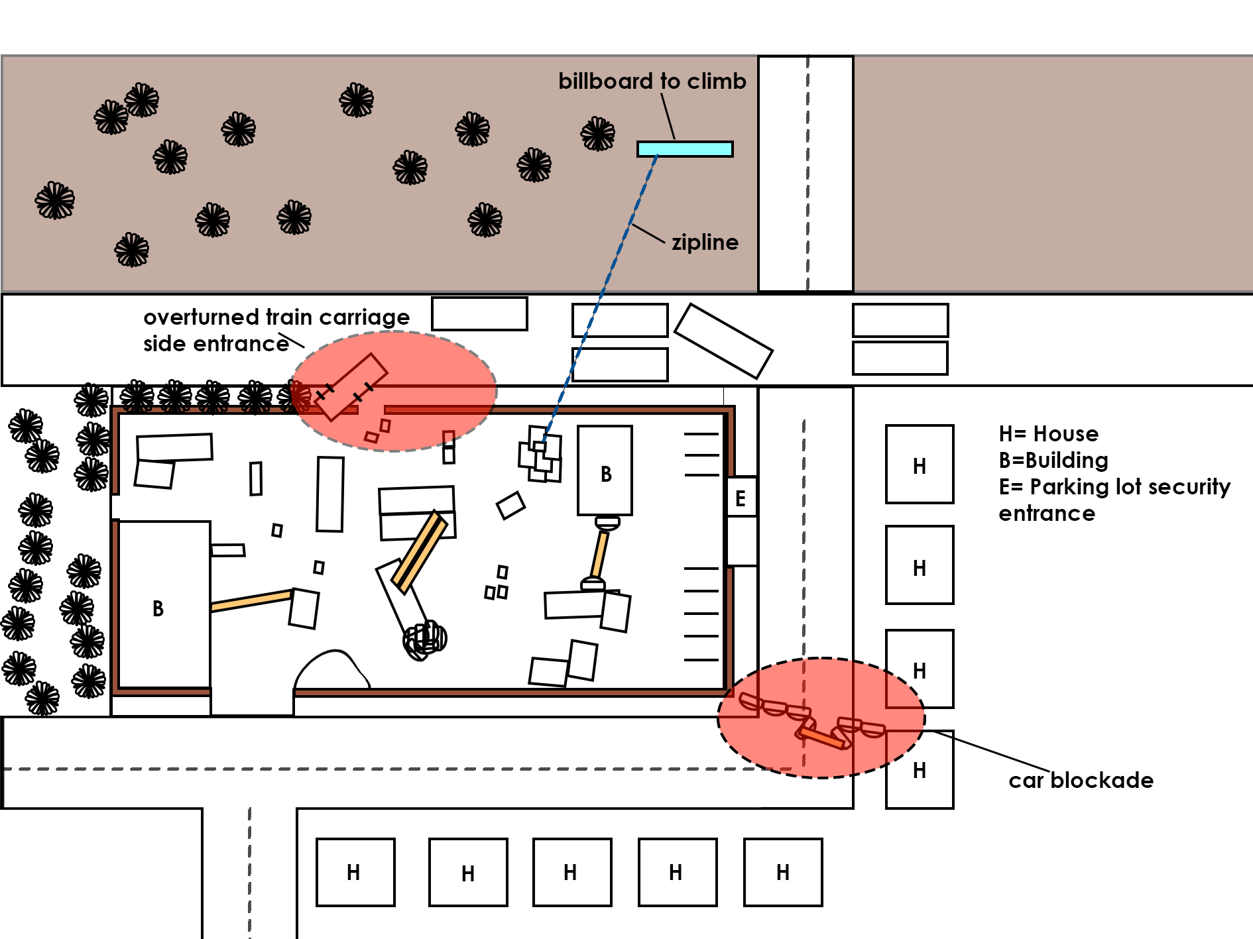
Rough level plan
What is my level trying to achieve?
-Make the most of all mechanics and chain them together in satisfying ways
-Create calmer transitional areas between segments
-To have a continuous environmental narrative
-Make all approaches seem viable and encourage the players to experiment
USP
-Story-like structure with multiple alarms
-Multiple transportation routes nearby so can realistically have a more diverse structure than other outposts
-Diverse setting
-Intensity of the level can higher the closer the player is to the visual landmarks
-More interior combat scenarios

Slide 8
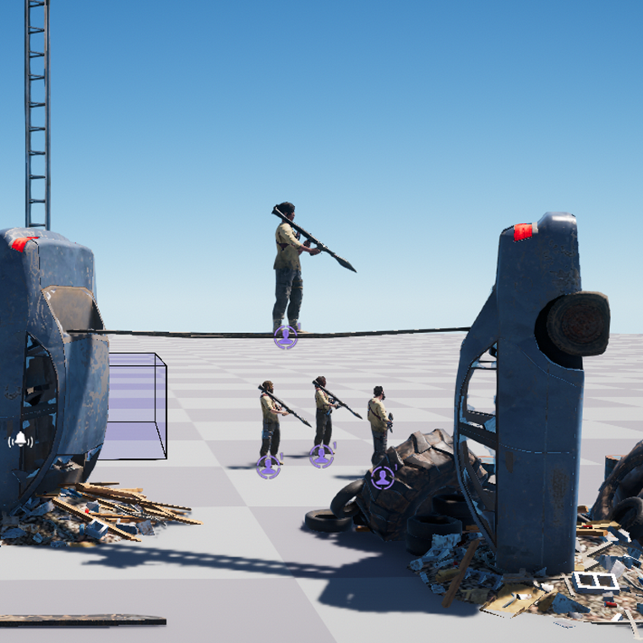
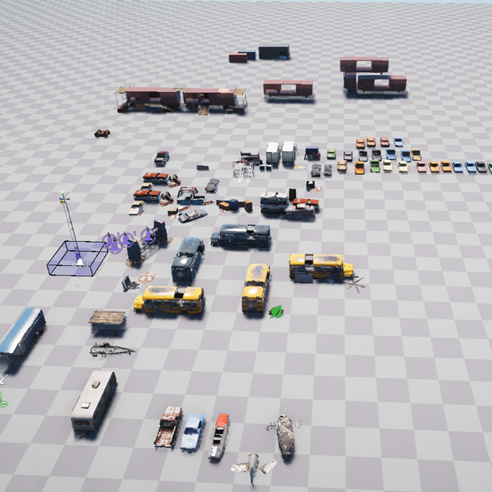
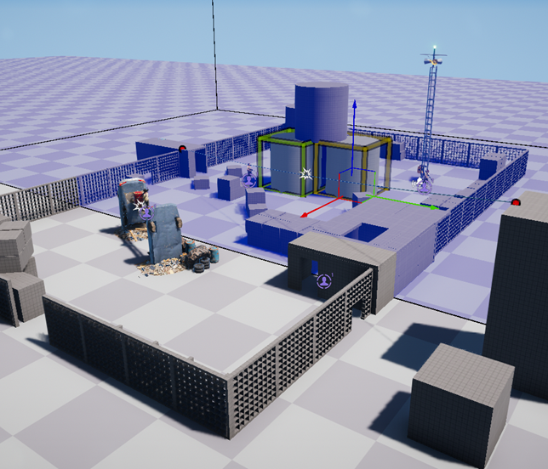
Implementation plan
I will use the Far Cry 5 arcade editor, which is intuitive and has plenty of tutorials available on YouTube.
Here is an example of a quick block out with working gameplay in editor I made.

Slide 9
Thanks for listening

